Slide 1

Bank Account Management System
Project Proposal Presentation
Presented by:
MD Hasan Sojib
Department of CSE, Uttara University

Slide 2
Project Overview
A software system to manage bank accounts digitally
Handles customer information and transactions
Reduces manual work and human errors
Designed for educational and small-scale use
Key Focus:
Account management
Transactions
Balance Inquiry

Slide 3
Introduction
Banking systems require accurate and secure data handling
Manual banking processes are time-consuming and error-prone
Digital systems improve efficiency and reliability
This project simulates a basic real-world banking system

Slide 4
Motivation
To reduce paperwork and manual record keeping
To ensure faster and accurate transactions
To learn real-life application of:
Database management
User authentication
CRUD operations
To gain practical software development experience

Slide 5
Related Works / Existing Features
Existing systems:
ATM systems
Online banking applications
Common features:
Account creation
Deposit and withdrawal
Balance inquiry
Transaction history

Slide 6
Contribution / Difference
Simple and user-friendly interface
Role-based access (Admin & User)
Focused on learning and demonstration
Lightweight and easy to deploy
Suitable for small institutions or academic use

Slide 7
Methodology
Development Steps:
Requirement analysis
System design
Implementation
Testing and validation
Proposed Technologies:
Frontend: React JS, Tailwind CSS
Backend: Node JS, Express JS
Database: MySQL

Slide 8
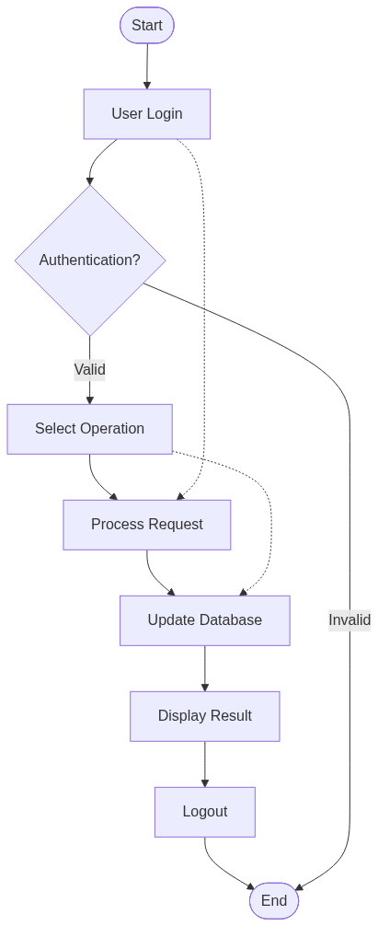
Flow Diagram
User login
Select banking operation
Perform transaction
Update database
Display result

Slide 9
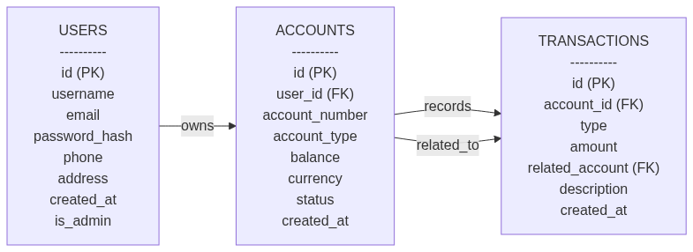
ER Diagram
Entities:
User
Account
Transaction
Relationships:
User owns Account
Account records Transactions

Slide 10
Conclusion
The system simplifies bank account management
Improves efficiency and accuracy
Provides hands-on experience in software development
Can be extended with:
Mobile banking
Advanced security
Reporting features

Slide 11
Thank You

